Slide 1
A Separate Data Structure For Online Multi-hypothesis Topological Mapping
2019/8/10
ChangYang Gong
龚畅阳

Slide 2
目录 Contents
演示视频

Slide 3
目录 Contents
1
CV Process
2
ROS Implementation
3
Result

Slide 4
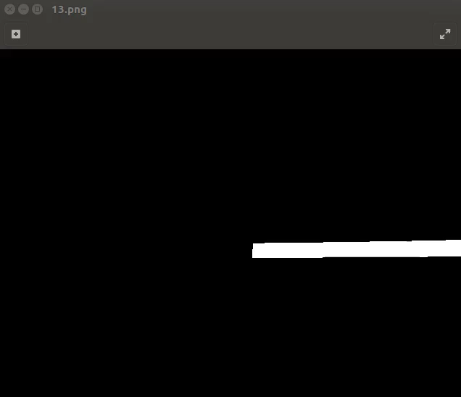
CV Process
Threshold segmentation
erode
dilate
margin detection
Hough Transform
Pick one Line in each direction

Slide 5
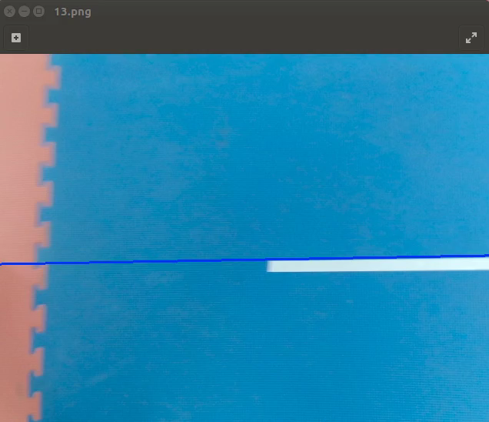
CV Process
Threshold segmentation
erode
dilate
margin detection
Hough Transform
Pick one Line in each direction

Slide 6
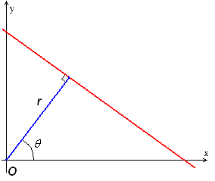
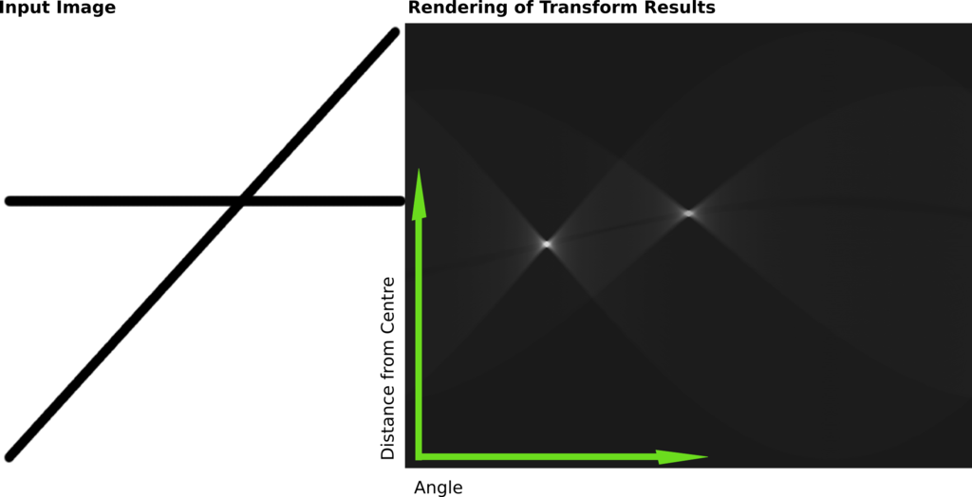
CV Process
Threshold segmentation
Hesse normal form
erode
dilate
margin detection
Hough Transform
Pick one Line in each direction

Slide 7
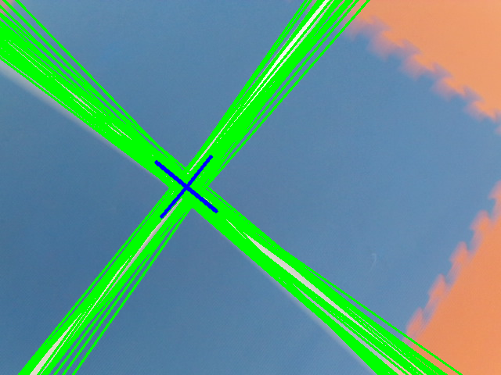
CV Process
Threshold segmentation
erode
dilate
margin detection
Hough Transform
Pick one Line in each direction

Slide 8
目录 Contents
1
CV Process
2
ROS Implementation
3
Result

Slide 9
Separated storage of hypothesis
Topo Node
Topo Edge
Map Candidate
Map Collection
Node Instance x3(real experience)
Node Collection

Slide 10
Separated storage of hypothesis
Robot
Node details are stored in node instances, the usage and references are connected to each other
1
2
3

Slide 11
Separated storage of hypothesis
New Instance!
4
At first consider it to be a brand new node
If it conflicts with the hypothesis, this map will be deleted
1
2
3

Slide 12
Separated storage of hypothesis
Check the usage in the map if it is possible
New Instance!
Find similar nodes
4
1
2
3

Slide 13
Separated storage of hypothesis
Clone the map with possible loop close
New Instance!
Find similar nodes
4
1
2
3

Slide 14
Separated storage of hypothesis
Modify it to be a loop closed one
New Instance!
Find similar nodes
4
1
2
3

Slide 15
Separated storage of hypothesis
Add the instance into node collection
New Instance!
Find similar nodes
4
1
2
3
4

Slide 16
Onboard Implementation
Ground truth
Serial
Serial
PX4
MAVROS
Xbee_comm
Xbee
Current
Pos
Pos
setpoint
ROS on UpBoard
CV
Infos
New Instance Information
CV
Processer
Local Controller
Topo mapping
CORE
USB
Next move choise
Current built maps
Industry
Camera
Wireless keyboard
HDMI
Topo
UI
FPV
USB

Slide 17
Simulation Implementation
New Instance Information
Topo
UI (Simulator)
Topo mapping
CORE
Next move choise
Current built maps
Topo
UI (Observer)

Slide 18
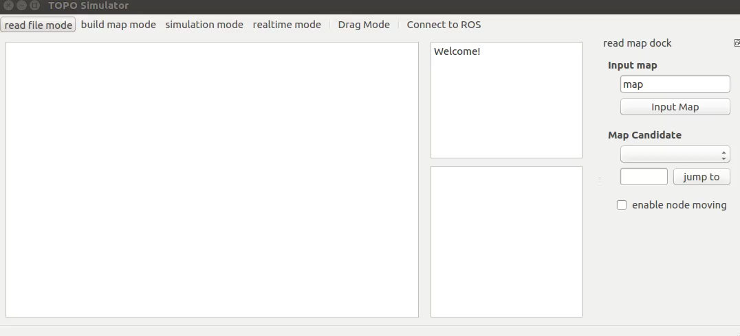
UI

Slide 19
目录 Contents
1
CV Process
2
ROS Implementation
3
Result

Slide 20
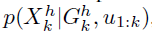
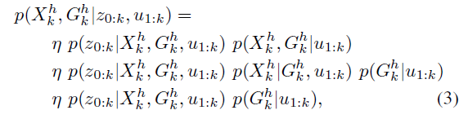
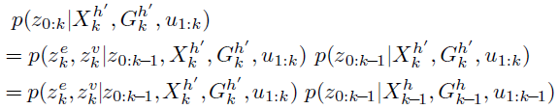
A bayesian framework
k: k steps in the map, from 0 to k
u: motions, move through which gate
z: measurements, odom, semantic
G: the map hypothesis
X: robot state, where it is
The robot always move as expected
=1
can be computed recursively

Slide 21
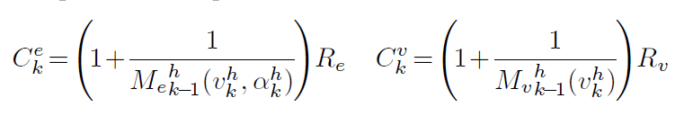
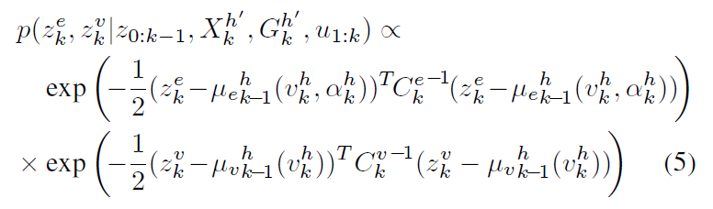
A bayesian framework
k: k steps in the map, from 0 to k
u: motions, move through which gate
z: measurements, odom, semantic
G: the map hypothesis
X: robot state, where it is
C conv with measure times
Indicates that the influence will be greater after serval measures
μ the average of the measurements

Slide 22
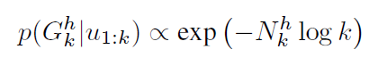
A bayesian framework
k: k steps in the map, from 0 to k
u: motions, move through which gate
z: measurements, odom, semantic
G: the map hypothesis
X: robot state, where it is
Adding a fractor
C conv with measure times
Indicates that the influence will be greater after serval measures
μ the average of the measurements

Slide 23
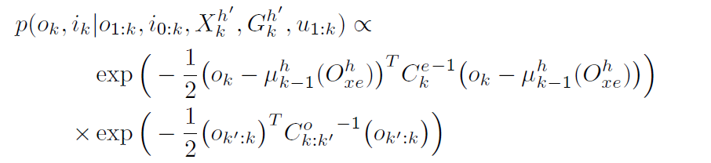
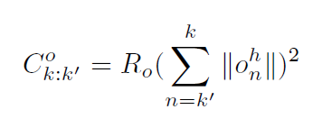
A bayesian framework
k: k steps in the map, from 0 to k
u: motions, move through which gate
z: measurements, odom, semantic
G: the map hypothesis
X: robot state, where it is

Slide 24
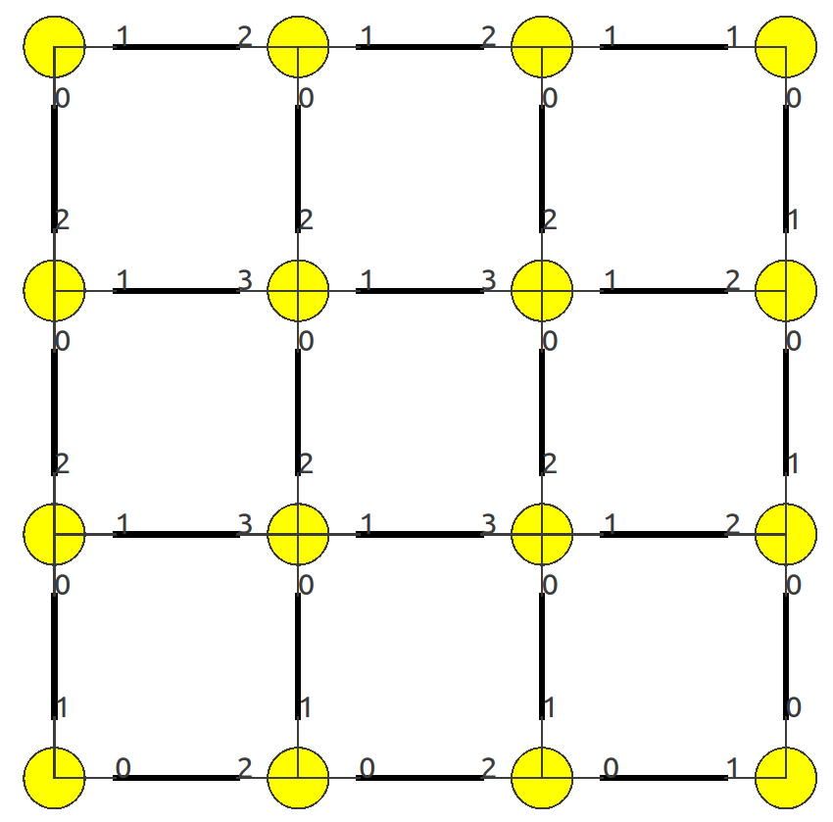
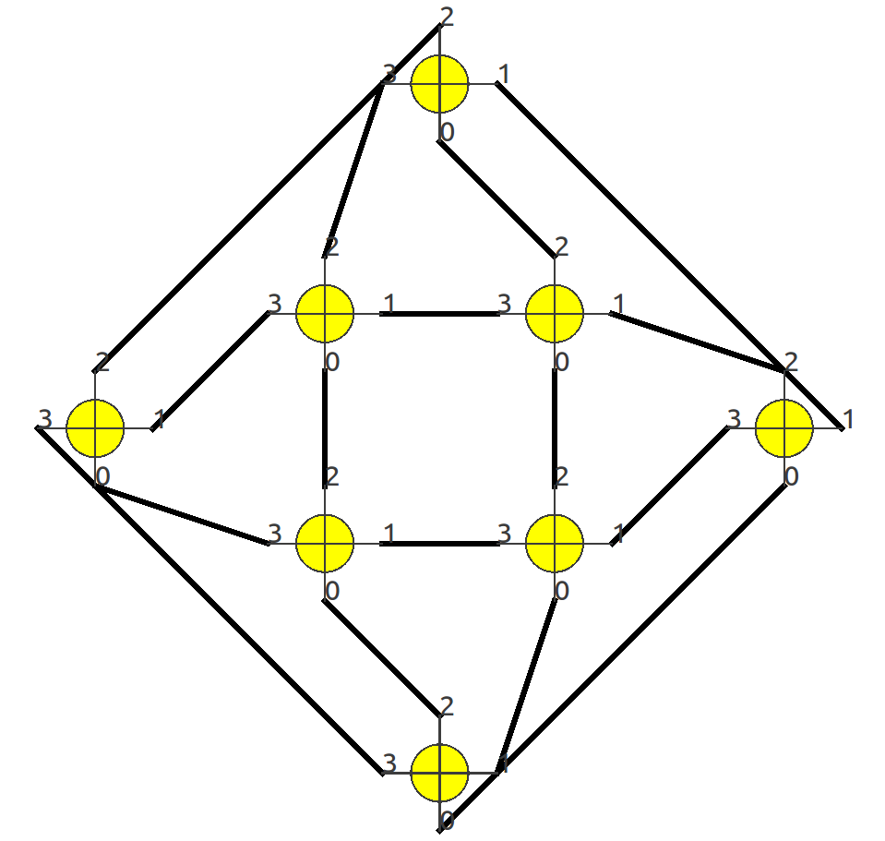
The map for simulation

Slide 25
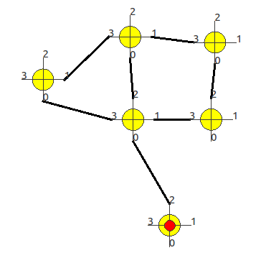
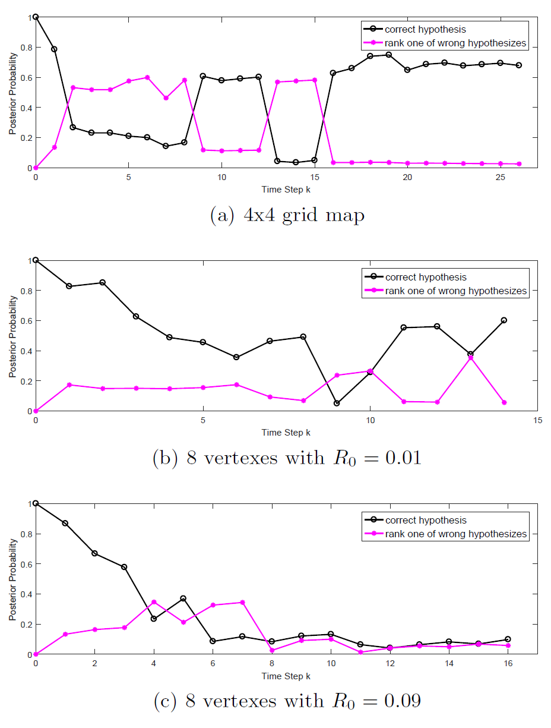
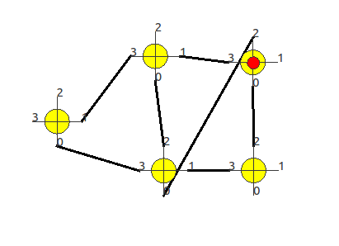
Result
True map
Wrong loop closure

Slide 26
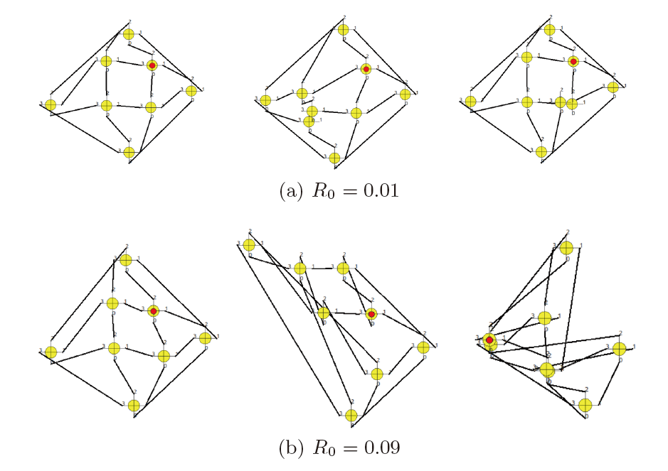
Result

Slide 27
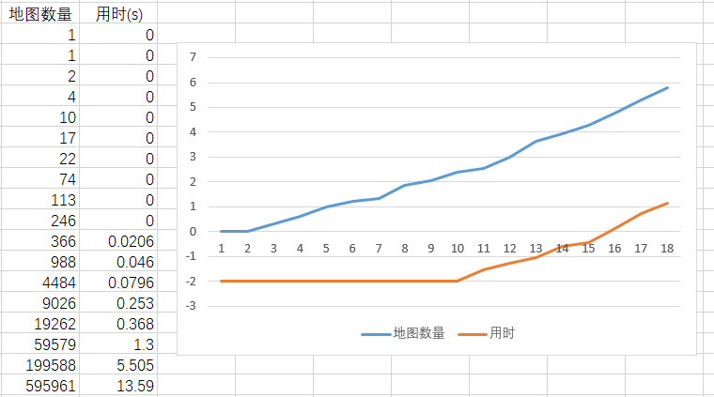
Secret Result

Slide 28
Thank You

